Slide 1
Areas of Assessment
Livelihood zones
Framework

Slide 2
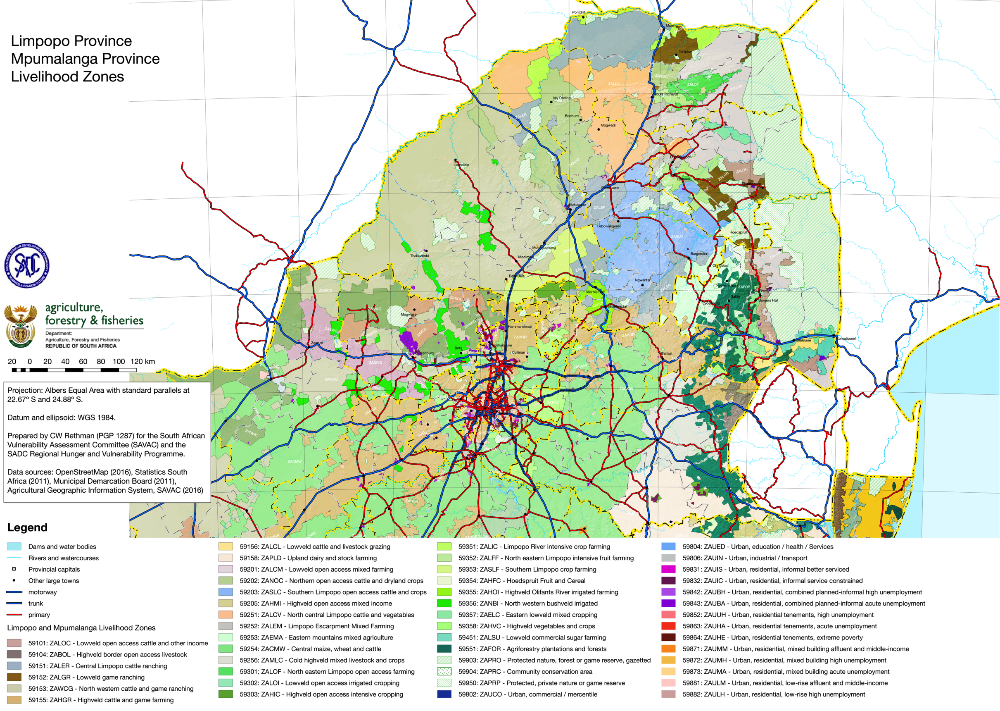

Slide 3
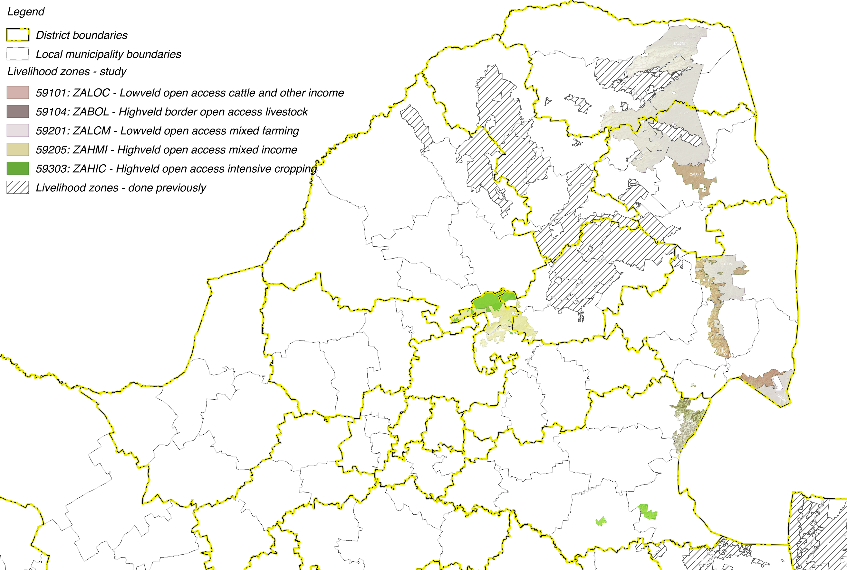

Slide 4
Livelihoods Findings:
Wealth Descriptions and Wealth Breakdowns

Slide 5
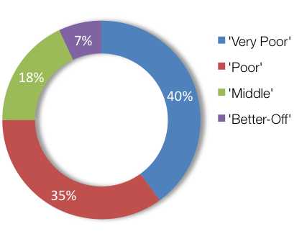
Wealth Breakdowns & Descriptions: ZALCM – Lowveld Open Access Mixed Farming (59201)
WEALTH GROUP | LIVESTOCK (cattle) | FARM SIZE (ha) | MAIN INCOME
Very Poor | 0 – 7 [4] | 1.0 | Grants
Poor | 3 – 10 [5] | 1.5 | Grants
Middle | 10 – 50 [20] | 2.0 | Employ
Better Off | 15 – 200 [50] | 2.0 | Employ/agric

Slide 6
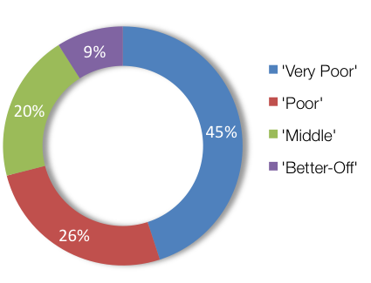
Wealth Breakdowns & Descriptions: ZALOC – Lowveld Open Access Cattle and Other Income (59101)
WEALTH GROUP | LIVESTOCK (cattle) | FARM SIZE (ha) | MAIN INCOME
Very Poor | 0 | 0.2 | Grants
Poor | 0 – 4 [2] | 0.3 | Grants
Middle | 0 – 15 [10] | 0.3 | Employ
Better Off | 5 – 60 [30] | 4.0 | Employ

Slide 7
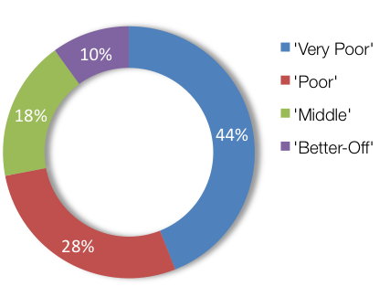
Wealth Breakdowns & Descriptions: ZABOL – Highveld border open access livestock (59104)
WEALTH GROUP | LIVESTOCK (cattle) | FARM SIZE (ha) | MAIN INCOME
Very Poor | 0 | 0.25 | Grants
Poor | 0 – 4 [3] | 0.5 | Grants
Middle | 5 – 13 [10] | 1.0 | Employ
Better Off | 10 – 25 [20] | 2.0 | Employ

Slide 8
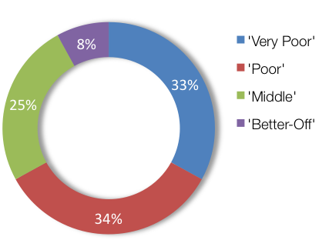
Wealth Breakdowns & Descriptions: ZAHIC – Highveld Open Access Intensive Cropping (59303)
WEALTH GROUP | LIVESTOCK (cattle) | FARM SIZE (ha) | MAIN INCOME
Very Poor | 0 | 0.75 | Grants
Poor | 0 – 4 [2] | 1.0 | Grants
Middle | 0 – 15 [10] | 1.2 | Employ
Better Off | 5 – 60 [30] | 2.0 | Employ/agric

Slide 9
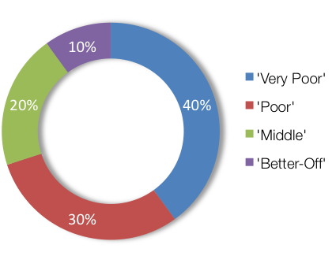
Wealth Breakdowns & Descriptions: ZAHMI – Highveld Open Access Mixed Income (59205)
WEALTH GROUP | LIVESTOCK (cattle) | FARM SIZE (ha) | MAIN INCOME
Very Poor | 0 | 0.5 | Grants
Poor | 0 – 7 [3] | 0.5 | Grants
Middle | 6 – 10 [8] | 0.5 | Employ
Better Off | 10 – 20 [15] | 0.5 | Employ

Slide 10
Livelihoods Findings:
Sources of Food and Income

Slide 11
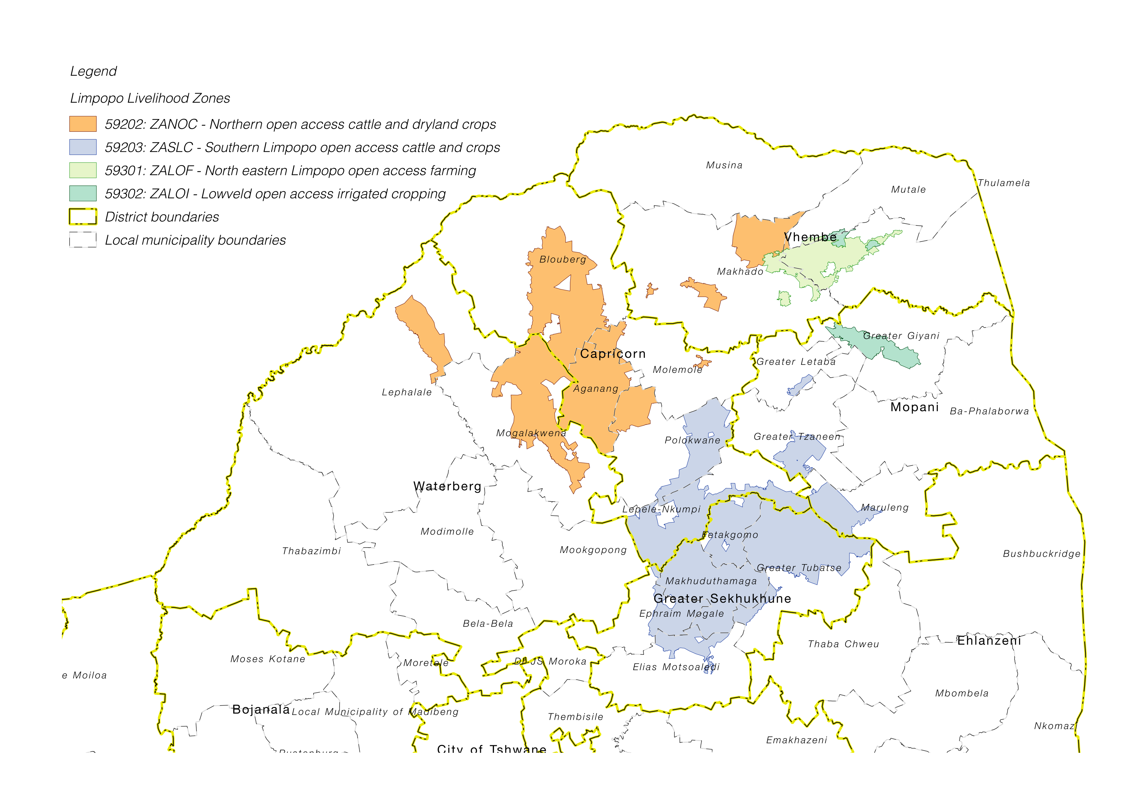
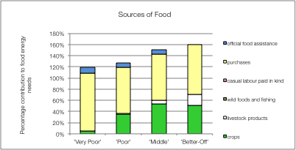
Source of Food: ZANOC – Northern Open Access Livestock and Dry Land Crops

Slide 12
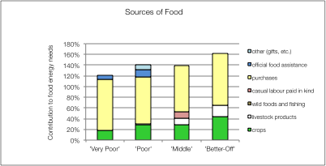
Sources of Food: ZASLC – Southern Limpopo Open Access Livestock and Crops
Key finding:
Low usage of livestock products (for given herd size)

Slide 13
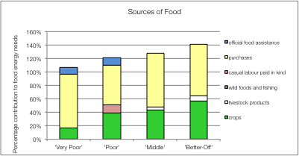
Sources of Food: ZALOF – North Eastern Limpopo Open Access Farming
Key finding:
Low yields and productivity

Slide 14
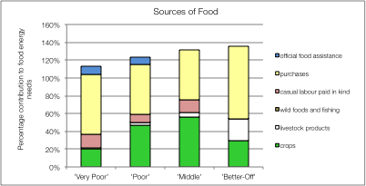
Sources of Food: ZALOI – Lowveld Open Access Irrigated Cropping

Slide 15
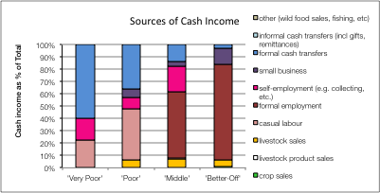
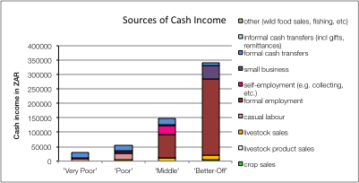
Source of Cash: ZANOC – Northern Open Access Livestock and Dry Land Crops

Slide 16
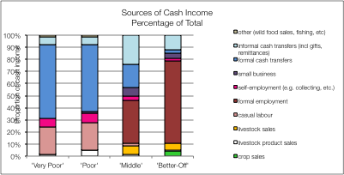
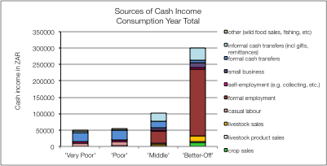
Sources of Cash: ZASLC – Southern Limpopo Open Access Livestock and Crops

Slide 17
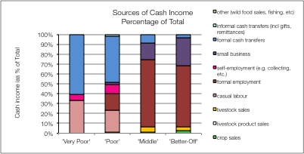
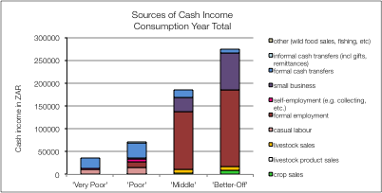
Sources of Cash: ZALOF – North Eastern Limpopo Open Access Farming

Slide 18
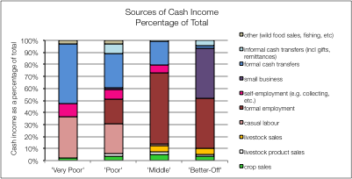
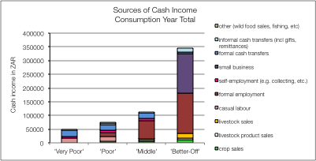
Sources of Cash: ZALOI – Lowveld Open Access Irrigated Cropping

Slide 19
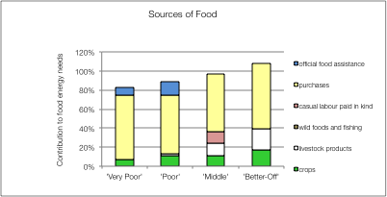
Example of a Forecast: ZASLC – Southern Limpopo Open Access Livestock and Crops
Food Prices Rise by 40%
Crop production falls by 60%
Affects food directly:

Slide 20
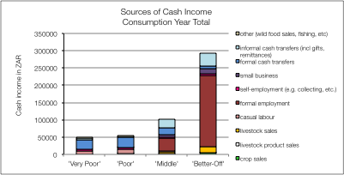
Example of a Forecast: ZASLC – Southern Limpopo Open Access Livestock and Crops
Households will try to manage
They will switch expenditure
But they can only switch their expenditure that is above the FPL
Lower Bound PL
Food PL

Slide 21
Example of a Forecast: ZASLC – Southern Limpopo Open Access Livestock and Crops
Households will try to manage
The FPL will rise by 40%
The LBPL limit will rise as well
Lower Bound PL
Food PL

Slide 22
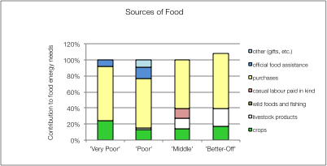
Example of a Forecast: ZASLC – Southern Limpopo Open Access Livestock and Crops
Hence:
By switching, Hhs can meet their basic food needs
BUT, they could be impoverished (below the LBPL)

